Slide 1
GameCo
Comparative Analysis of the Top Three Video Game Markets
Padma Kumari Mullapudi

Slide 2
Overview
Motivation: Gameco is a new video game company looking to make data informed decisions on the development of new games.
Objective​:​ ​Determine the most popular games, publishers and sales figures across different regions.
Key Questions
How do sales vary across different regions?
Have sales decreased or increased over time?
In which regions are specific genres most popular and least popular?
Data Set
Project Brief
Data Source: Video Games Sales Dataset
VGChartz.
Methods utilized
Pivot Tables
Presenting Results in PowerPoint
Utilized dynamic Excel visualizations (Line Charts, Column Charts,)

Slide 3

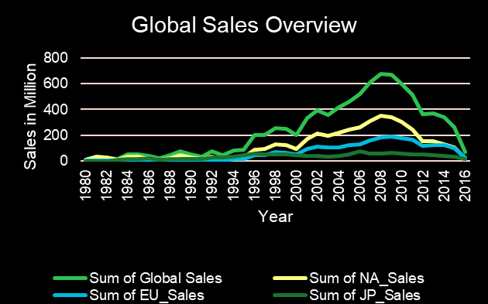
SALES TRENDS FOR ALL REGIONS FROM 1991 -2016
The situation seems similar when we look at sales from different regions compared to global sales. The drop in sales in North America has impacted global sales because North America has always been the region with the highest sales.

Slide 4
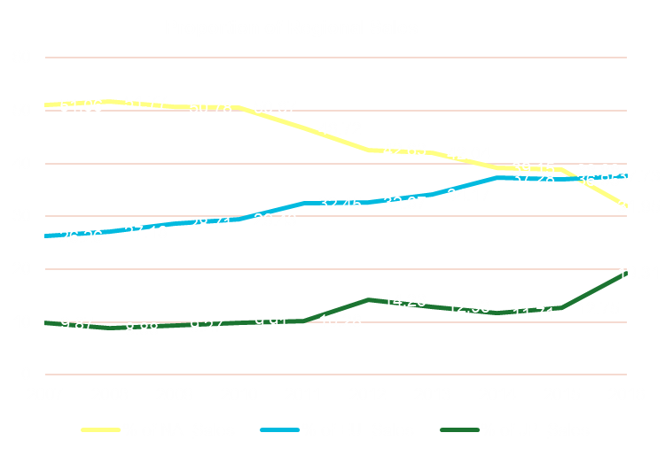
Proportion of Regional Sales for last 10 years
If we look at the year 2016 in isolation, we can notice a somewhat different trend. We have been able to assume that the NA region has dominated the market throughout the years, but this does not seem to be the case in 2016. It is clear from this illustration that the EU region has overtaken the NA region, and this further underlines the decline that has occurred in the NA region.

Slide 5
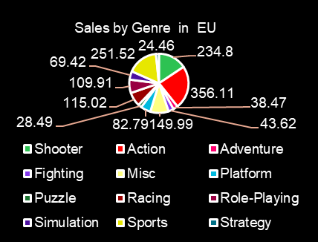
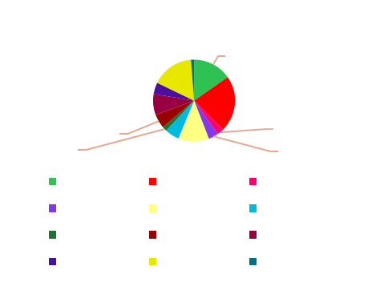
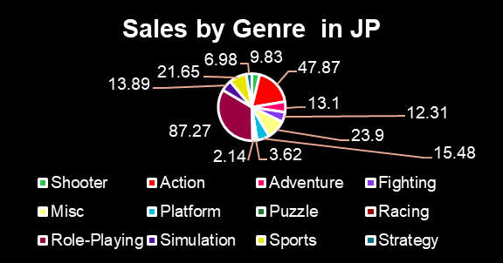
Percentage of sales by Genre in : 2007 - 2016
In the North American market over the past 10 years:
  The top three genres based on the percentage of sales are Action, Shooter, and Sports
When analyzing the sales in Europe over the past 10 years by genre:
  The top three genres in terms of percentage of sales are Action, Shooter, and Sports.
When examining the sales in Japan over the past 10 years by genre:
  The top three genres showcase a different trend compared to other regions. Role Playing ,Action, and Misc.

Slide 6
Conclusion & Recommendation
The decline in sales in the NA region must be further investigated. I believe that it is in the best interest of GameCo to try and restore the dominance of the NA market.
The top performing genres in each region should be prioritized. Marketing and Sales budgets should be built around them in order to increase revenue.
The EU region should receive the highest budget allocation for any of the regions. This is because the region has consistently grown in the last 10 years (26% to 38%) and this is an avenue that can be exploited successfully.

